Slide 1
Quick Switch UK Limited
The operation cycle of the semi-automatic quick hitch with the Quick Switch Warning System Fitted

Slide 2
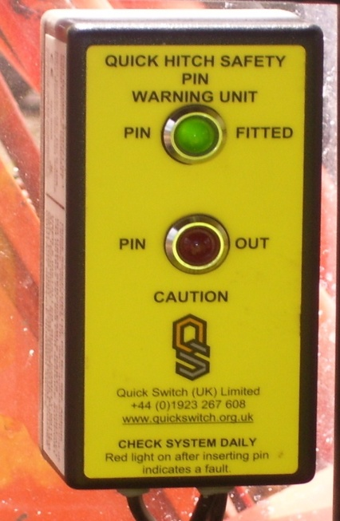
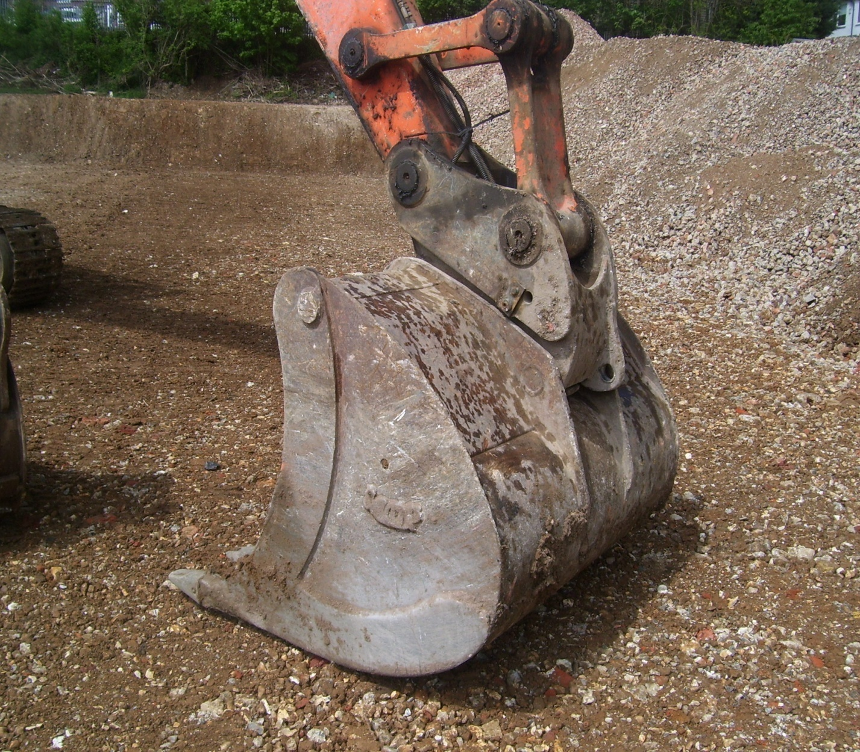
Lower bucket to the ground. At this stage the safety pin is fitted and the warning unit in the cab registers this by an illuminated green LED.

Slide 3
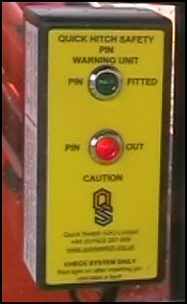
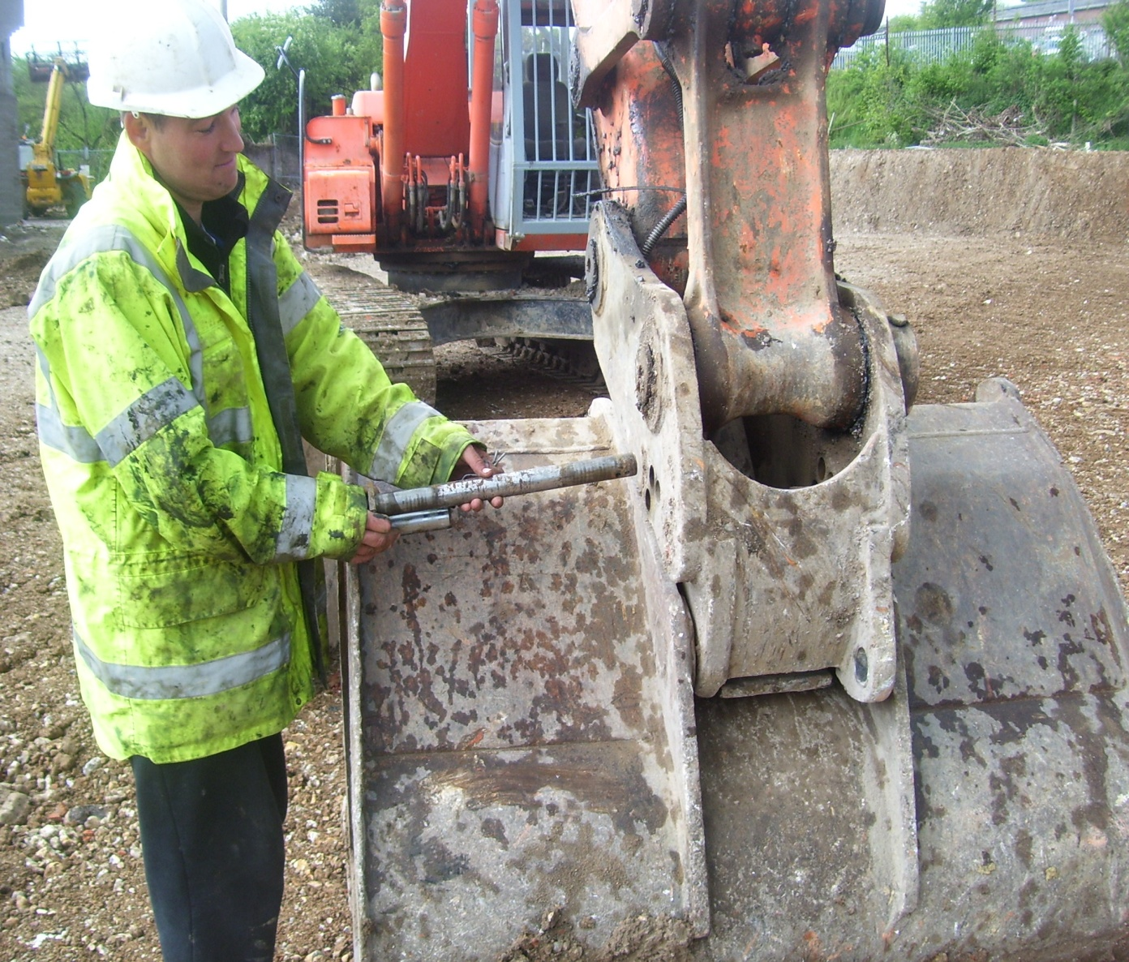
The Operator exits the cab to remove the safety pin. At this point the red LED and internal sounder on the warning unit are activated. The external siren/beacon is also activated.

Slide 4
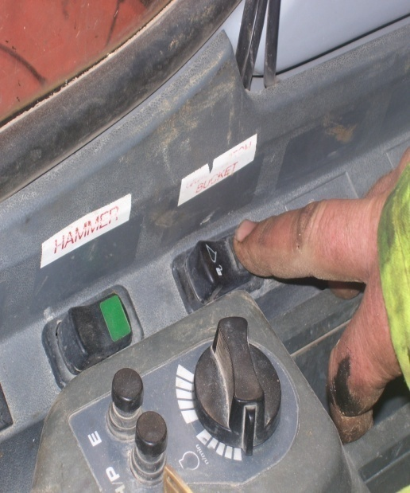
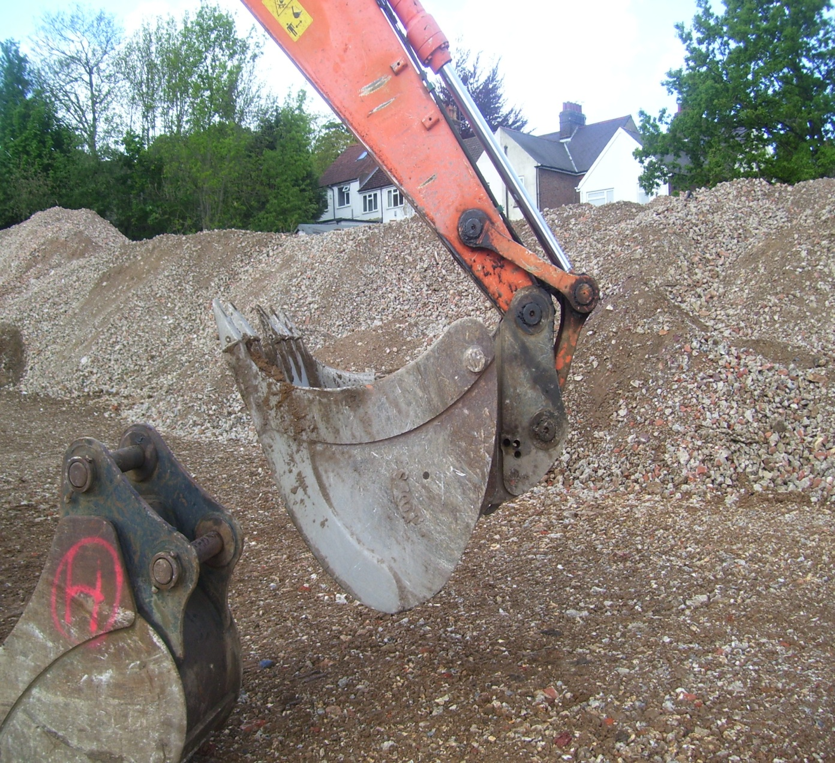
The Operator activates quick hitch hydraulics via electrical switch in cab and buzzer activates to warn that the hitch is disengaging.
Operator curls bucket inwards which powers open quick hitch ram.

Slide 5
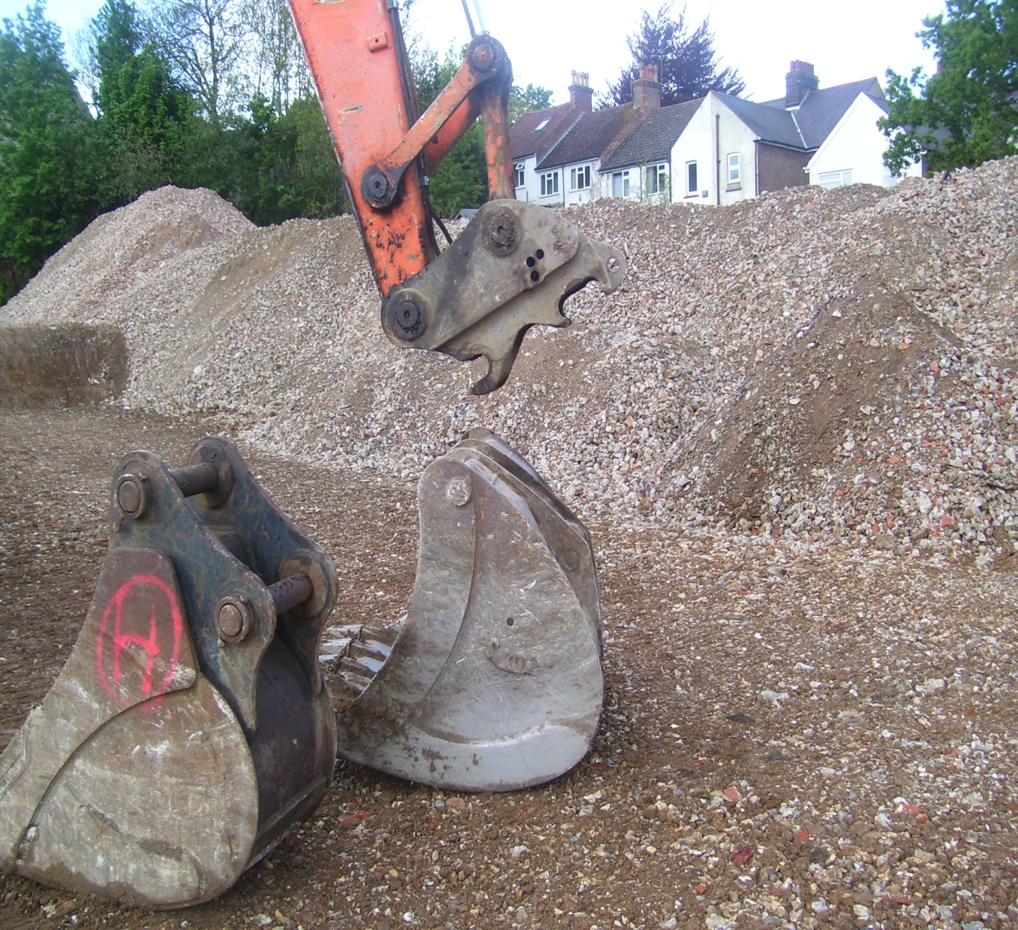
The bucket can now be disengaged and replaced with another attachment.
The Quick Switch system remains activated throughout the operation.

Slide 6
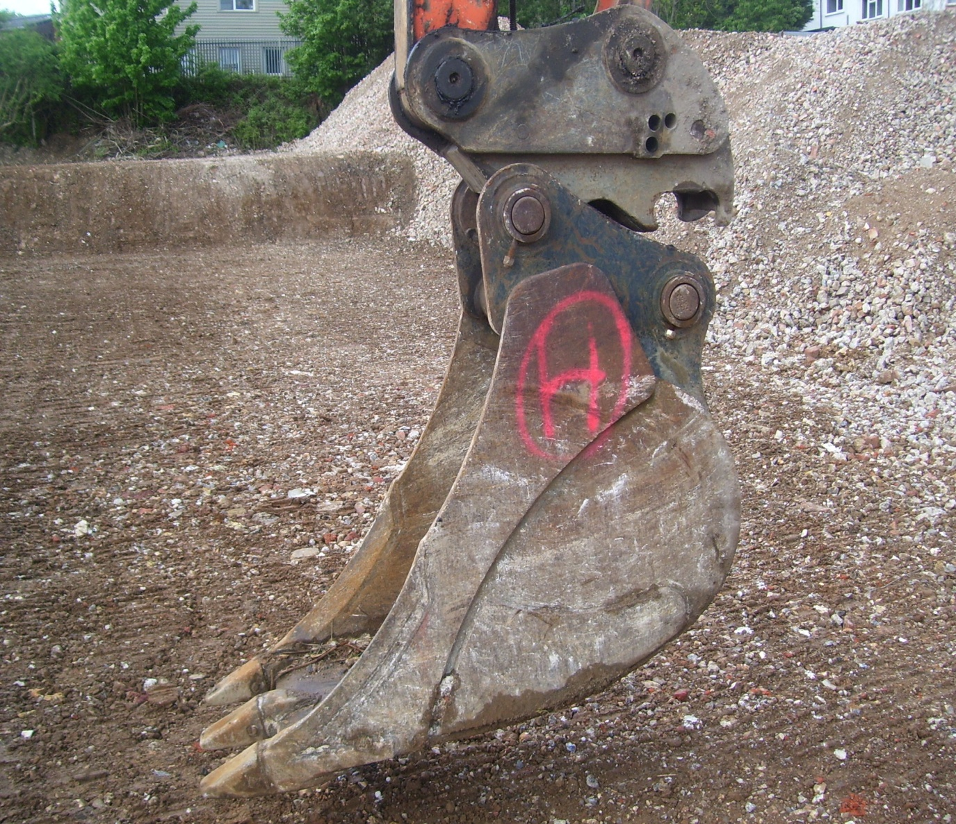
A different attachment can now be picked up on the front pin.
The Operator then curls the bucket inwards so as to engage rear pin into receiving aperture of the quick hitch chassis.

Slide 7
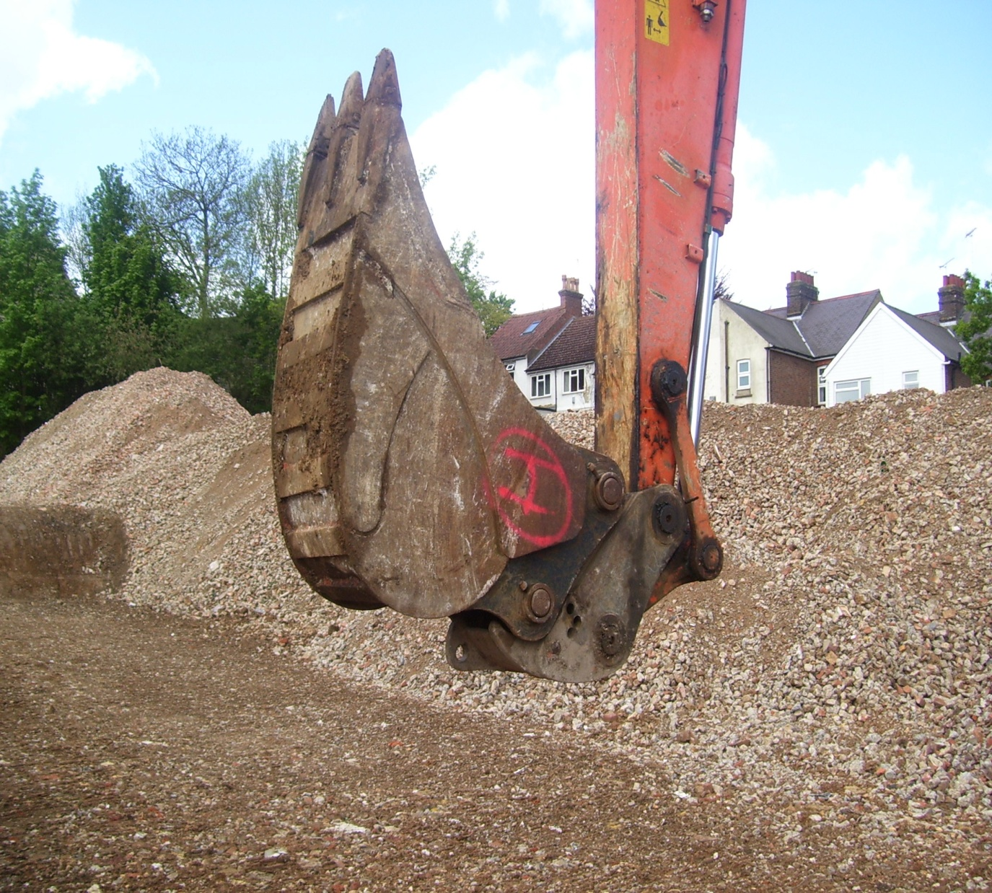
The quick hitch hydraulics are now re-engaged via the electrical switch in cab.
The bucket is curled in further to power in the hitch ram. The bucket is now clamped securely in place and then lowered to the ground.

Slide 8

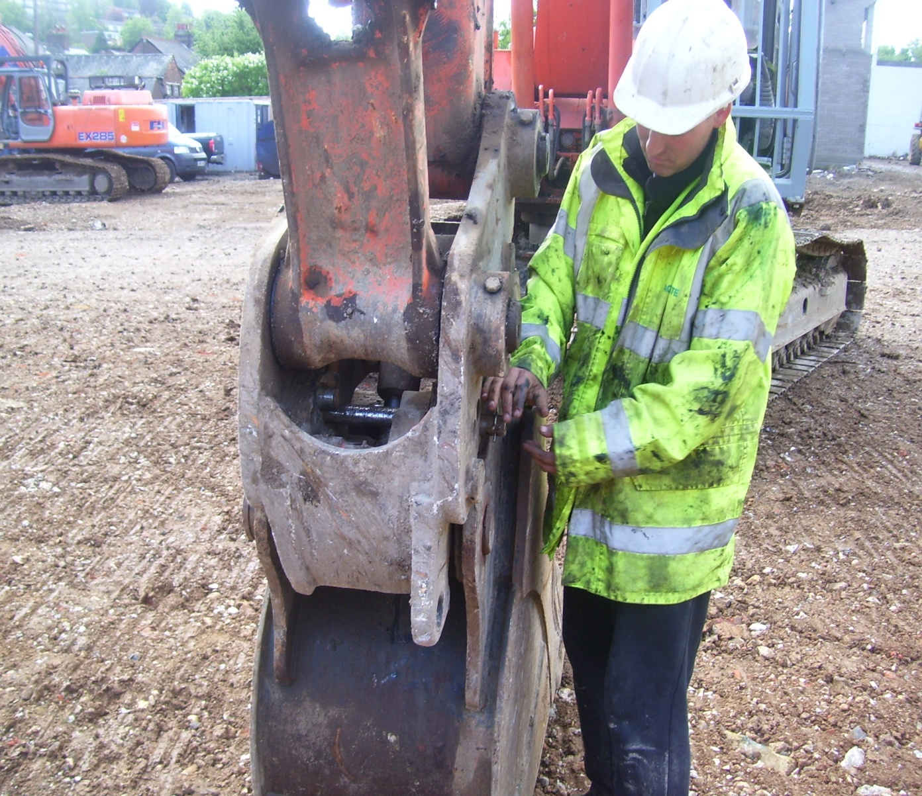
The Operator now visually checks that the engagement system has connected correctly.
The safety pin and retaining clip can now be fitted at which point the Quick Switch system alarms (visual and audible) will deactivate.

Slide 9
Final Check
The Operator must now carry out the final check by shaking the bucket and then rolling the back of the bucket on the ground to ensure it does not detach.

